Slide 1
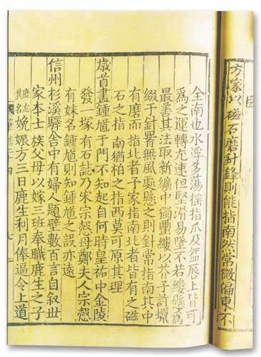
Magnetism
Magnetic phenomena have been known to humankind for a long time
Many accounts from ancient Greece, India, and China, dating back to 600 BC.
Around AD 50, Chinese literature documented the attraction of a needle by a lodestone
Around AD 1000, methods of making a compass for navigation was documented by Chinese
Notes:
北宋时，曾公亮在《武经总要》载有制作和使用指南鱼的的方法：“用薄铁叶剪裁，长二寸，阔五分，首尾锐如鱼型，置炭火中烧之，侯通赤，以铁钤钤鱼首出火，以尾正对子位，蘸水盆中，没尾数分则止，以密器收之。用时，置水碗于无风处平放，鱼在水面，令浮，其首常向午也。”这是一种人工磁化的方法，它利用地球磁场使铁片磁化。即把烧红的铁片放置在子午线的方向上。烧红的铁片内部分子处于比较活动的状态，使铁分子顺着地球磁场方向排列，达到磁化的目的。蘸入水中，可把这种排列较快地固定下来，而鱼尾略向下倾斜可增大磁化程度。人工磁化方法的发明，对指南针的应用和发展起了巨大的作用。在磁学和地磁学的发展史上也是一件大事。北宋的沈括在《梦溪笔谈》中提到另一种人工磁化的方法：“方家以磁石摩针锋，则能指南。”按沈括的说法，当时的技术人员用磁石去摩擦缝衣针，就能使针带上磁性。从现在的观点来看，这是一种利用天然磁石的磁场作用，使钢针内部磁畴的排列趋于某一方向，从而使钢针显示出磁性的方法。这种方法比地磁法简单，而且磁化效果比地磁法好，摩擦法的发明不但世界最早，而且为有实用价值的磁指向器的出现，创造了条件。

Slide 2
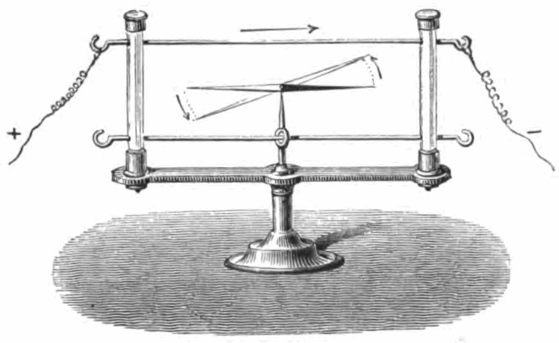
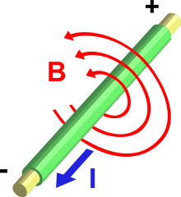
Electromagnetism
In 1820, Hans Christian Ørsted discovered that a compass needle could turn its direction from north when an electric current is turn on nearby
André-Marie Ampère further showed that showed that two parallel wires carrying electric currents attract or repel each other, depending on whether the currents flow in the same or opposite directions, respectively
Ampère also formulated the mathematics explaining the physics of electromagnetism

Slide 3
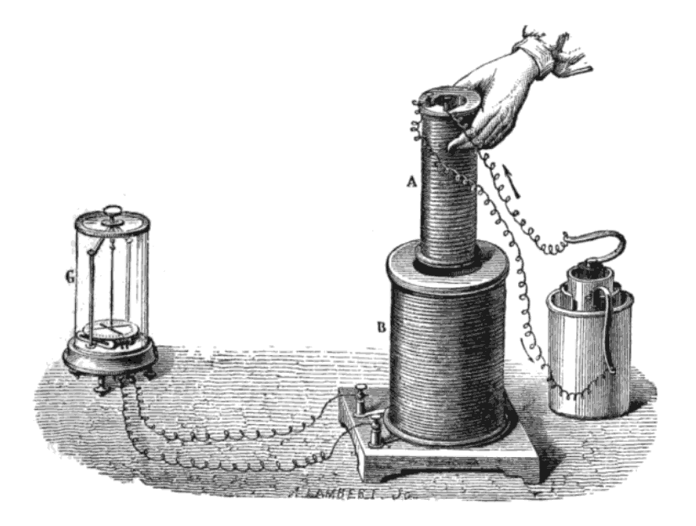
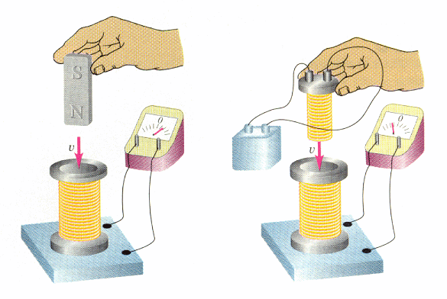
Electromagnetic Induction
Around 1831, Michael Faraday experimentally demonstrated that a moving magnet can induce electric voltage
This gives a big clue about the unification of electricity and magnetism
This also lead to the invention of electric generator
Faraday also demonstrated mutual induction, electric motor, and proposed the concept of electromagnetic “field” --- an interaction that extends beyond physical contact

Slide 4
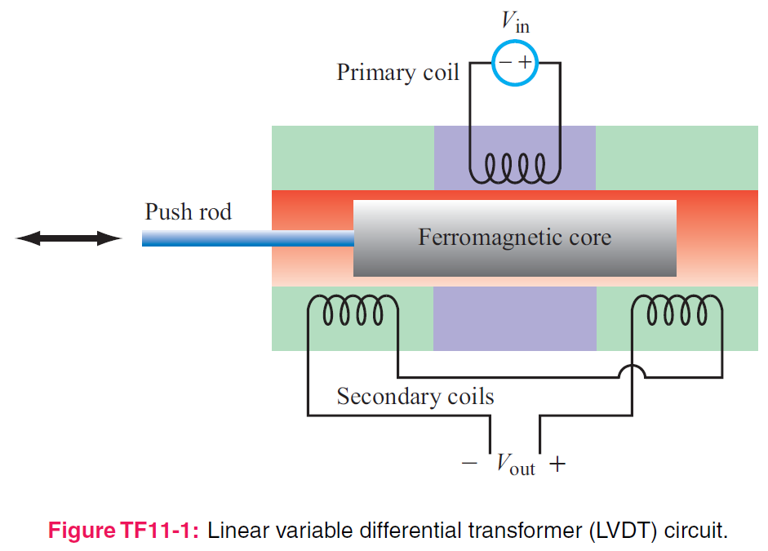
5. Magnetostatics
Applied EM by Ulaby, Michielssen and Ravaioli

Slide 5
Electric vs Magnetic Comparison
Magnetic Force and Torque
Biot-Savart Law
Ampere's Law
Magnetic Properties of Materials
Boundary Conditions
Inductance
Magnetic Energy

Slide 6
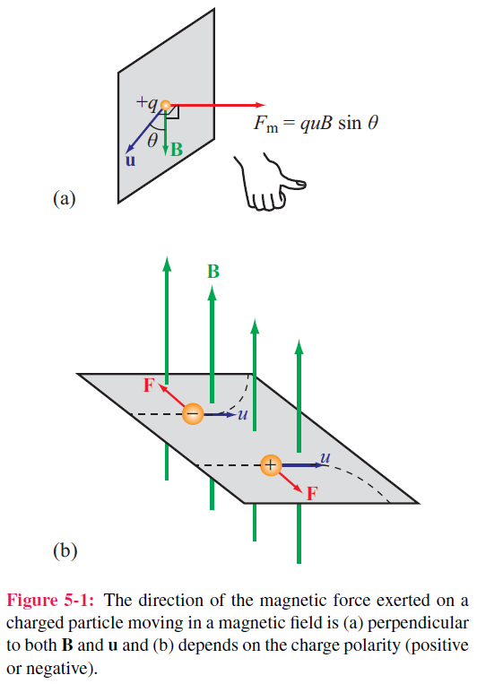

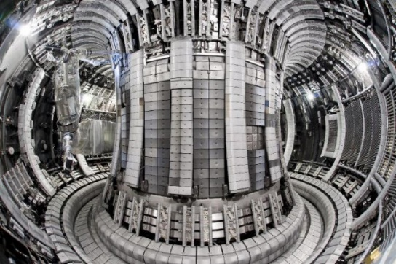
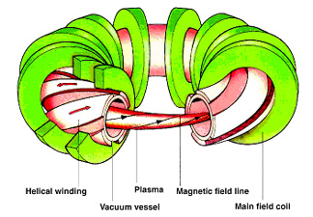
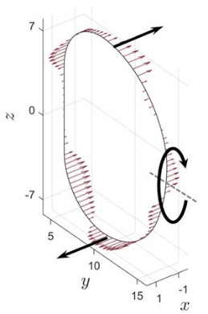
Electric & Magnetic Forces
Magnetic force
Fusion Reactor
Electromagnetic (Lorentz) force

Slide 7
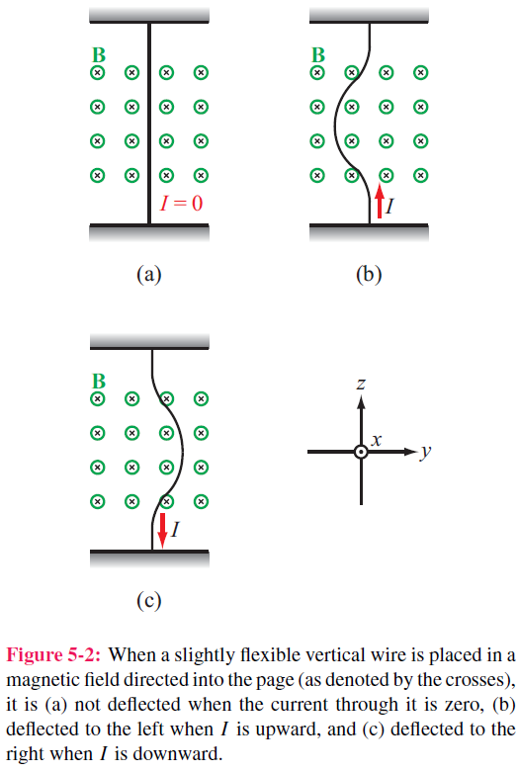
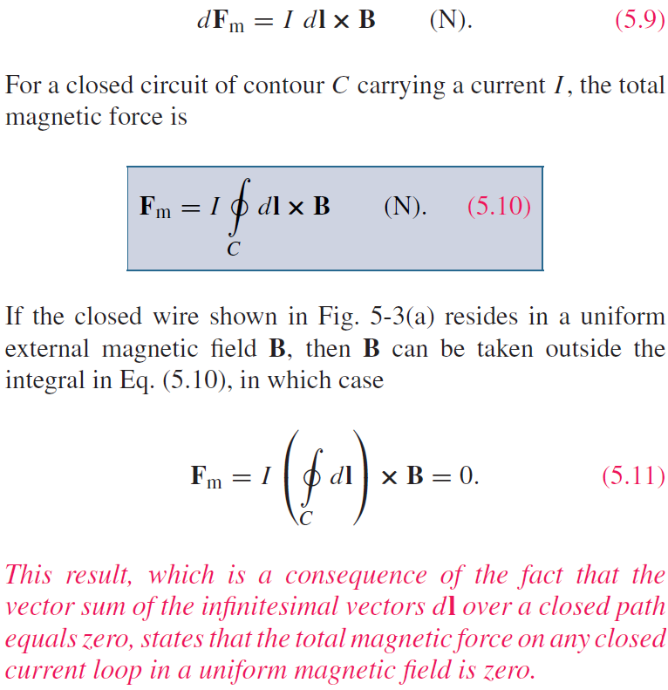
Magnetic Force on a Current Element
Differential force dFm on a differential current I dl:

Slide 8
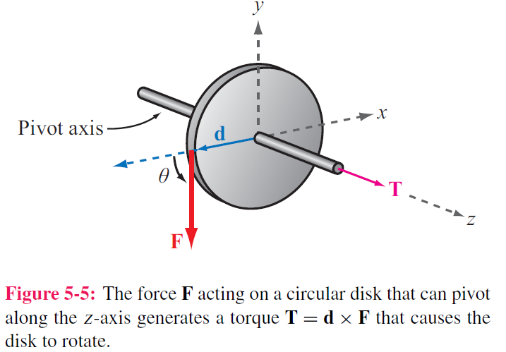

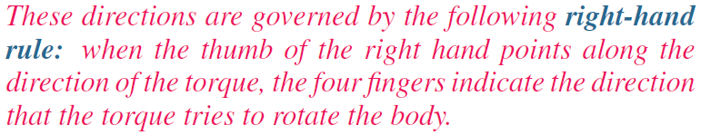
Torque
d = moment arm
F = force
T = torque

Slide 9
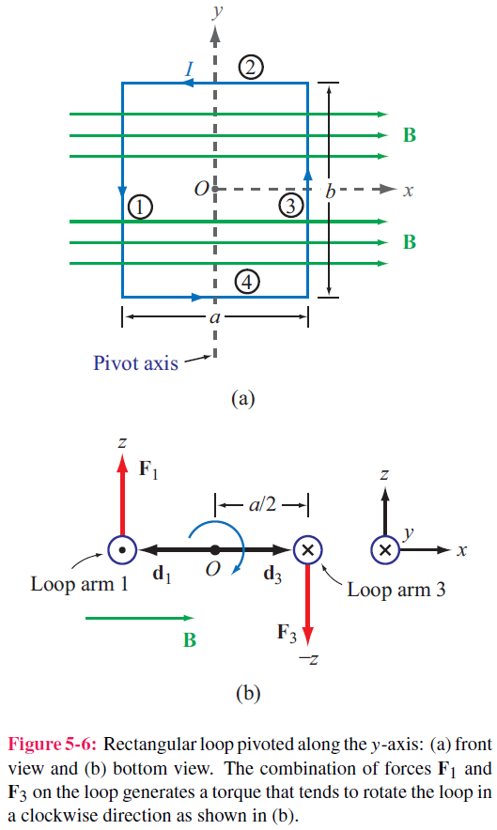
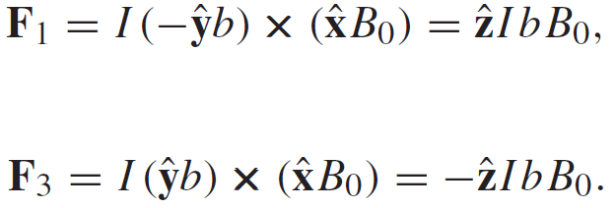
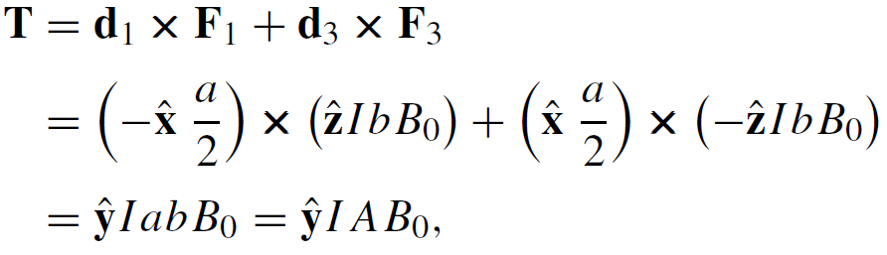
Magnetic Torque on Current Loop
No forces on arms 2 and 4 ( because I and B are parallel, or anti-parallel)
Magnetic torque:
Area of Loop

Slide 10
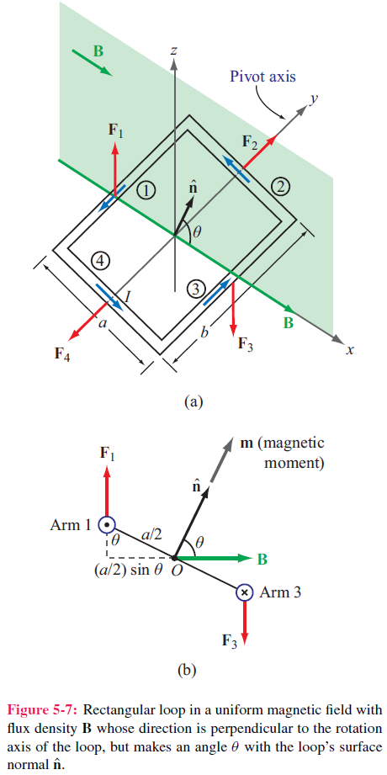
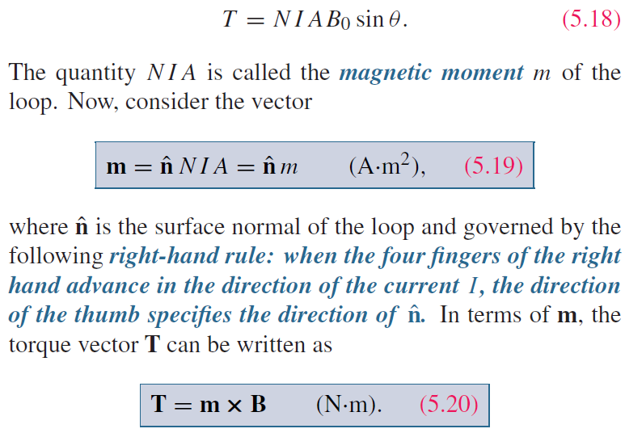
Inclined Loop
For a loop with N turns and whose surface normal is at angle theta relative to B direction:

Slide 11
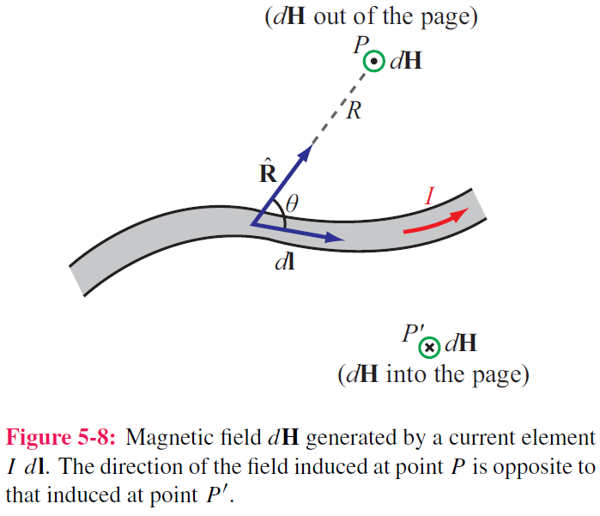

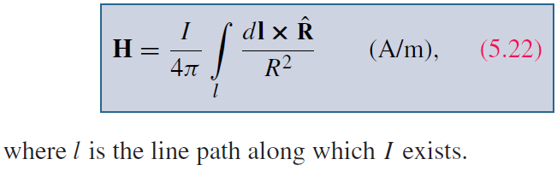
Biot-Savart Law
Magnetic field induced by
a differential current:
For the entire length:

Slide 12
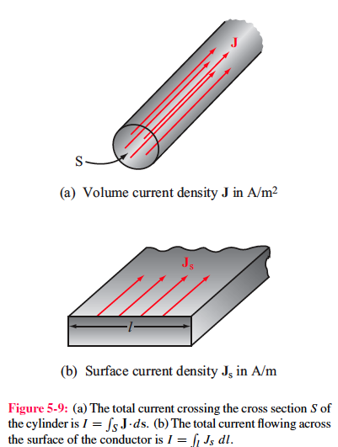
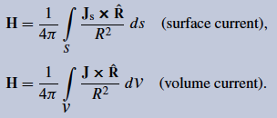
Magnetic Field due to Current Densities

Slide 13
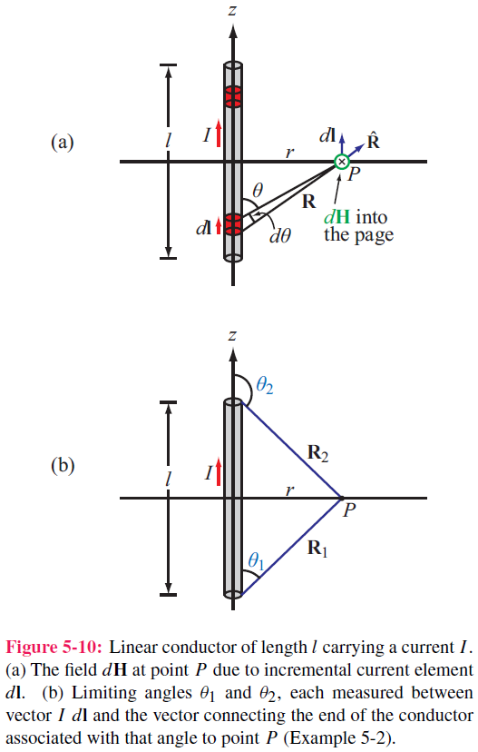
Example 5-2: Magnetic Field of Linear Conductor
Cont.

Slide 14
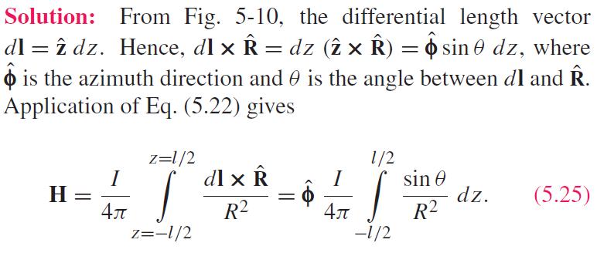
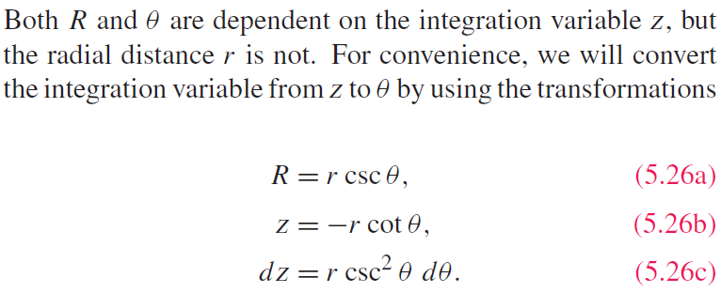
Example 5-2: Magnetic Field of Linear Conductor
Cont.

Slide 15
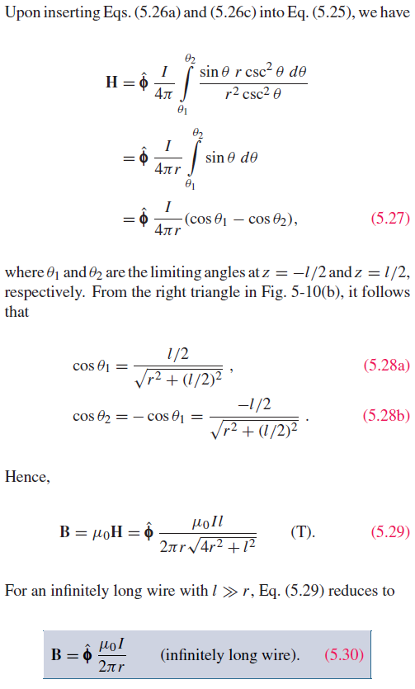
Example 5-2: Magnetic Field of Linear Conductor

Slide 16
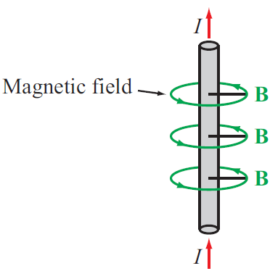

Magnetic Field of Long Conductor

Slide 17
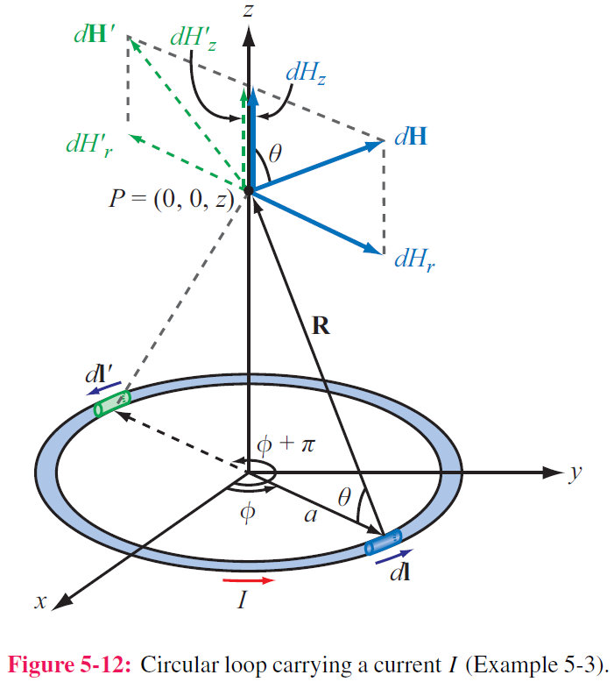
Example 5-3: Magnetic Field of a Loop
Magnitude of field due to dl is
Cont.

Slide 18
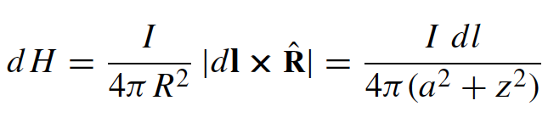
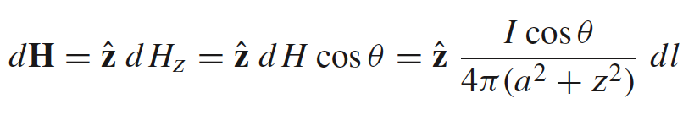
Example 5-3: Magnetic Field of a Loop
Magnitude of field due to dl is
dH is in the r–z plane , and therefore it has
components dHr and dHz
z-components of the magnetic fields due to dl and dl’ add because they are in the same direction,
but their r-components cancel
Hence for element dl:
Cont.

Slide 19
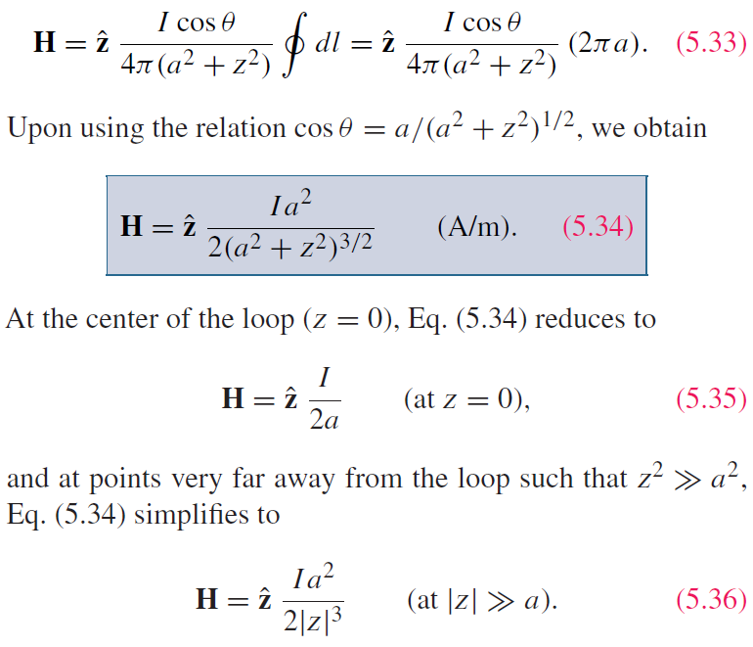
Example 5-3:Magnetic Field of a Loop (cont.)
For the entire loop:

Slide 20
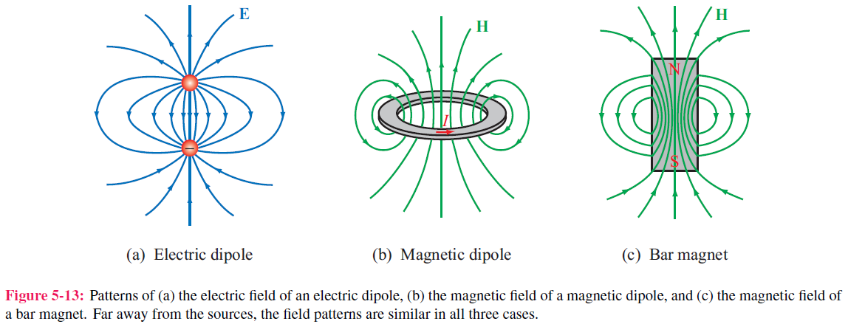
Magnetic Dipole
Because a circular loop exhibits a magnetic field pattern similar to the electric field of an electric dipole, it is called a magnetic dipole

Slide 21
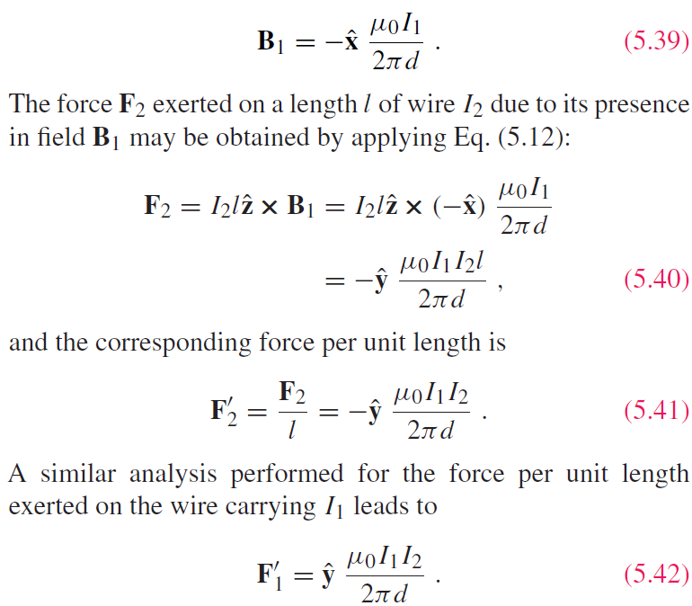
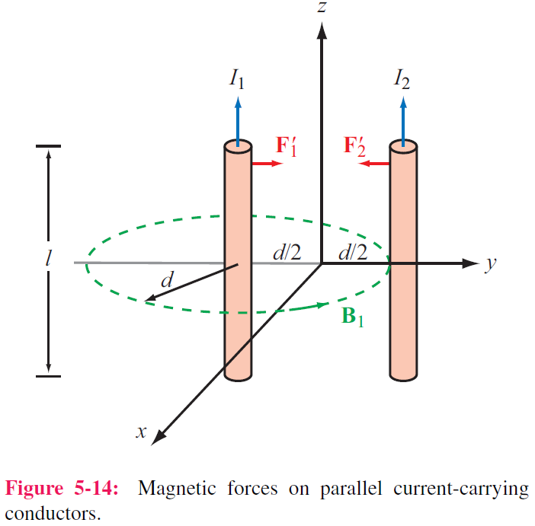
Forces on Parallel Conductors
Parallel wires attract if their currents are in the same direction, and repel if currents are in opposite directions

Slide 22
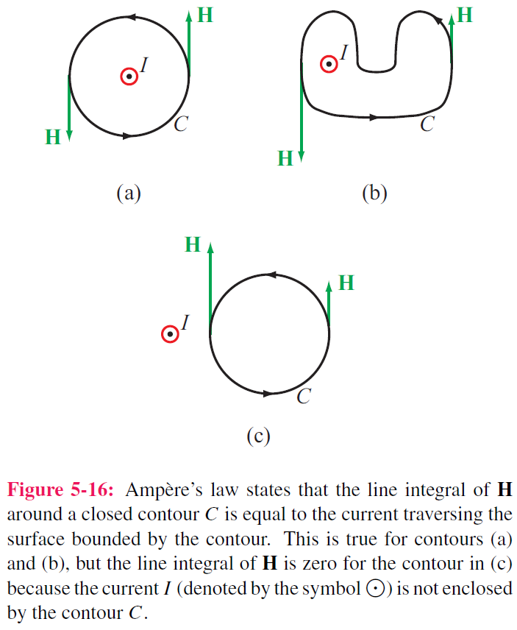
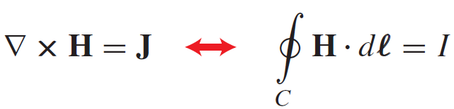
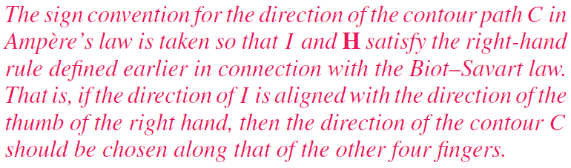
Ampère’s Law

Slide 23
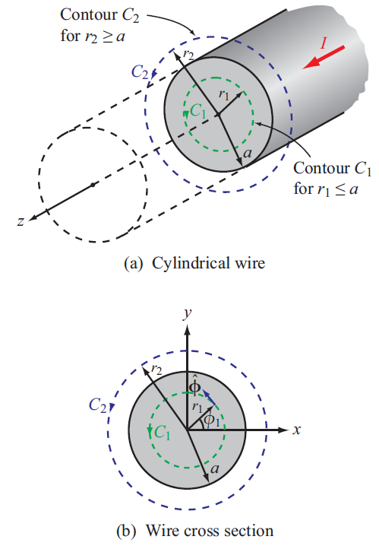
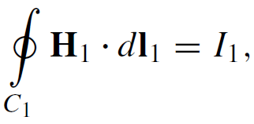
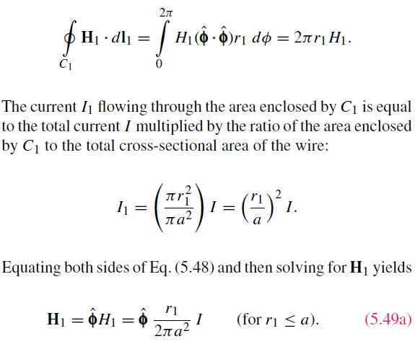
Internal Magnetic Field of Long Conductor
For r < a
Cont.

Slide 24
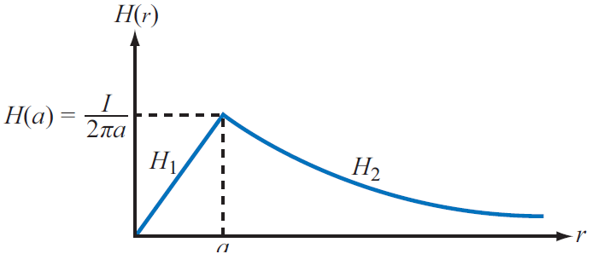
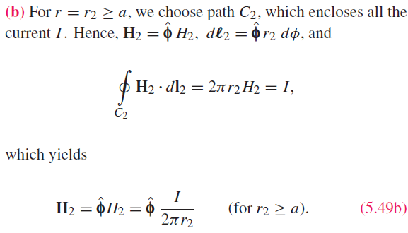
External Magnetic Field of Long Conductor
For r > a

Slide 25
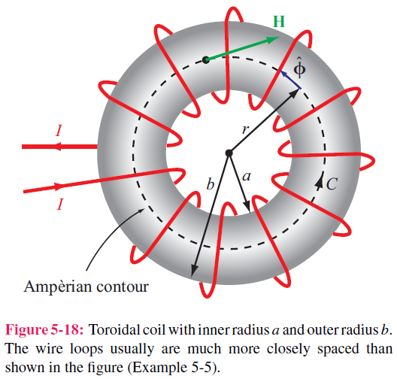
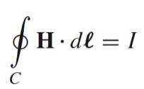
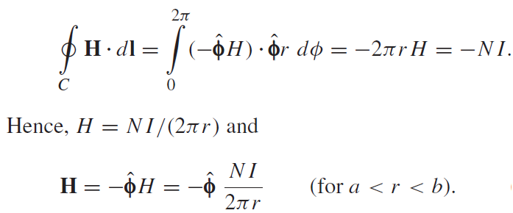
Magnetic Field of Toroid
Applying Ampere’s law over contour C:
Ampere’s law states that the line integral of H around a closed contour C is equal to the current traversing the surface bounded by the contour.
The magnetic field outside the toroid is zero. Why ?

Slide 26




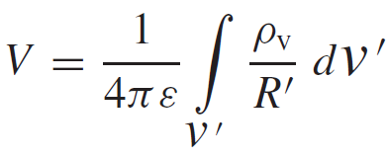
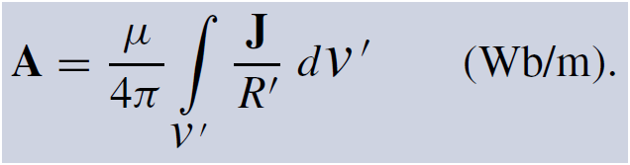
Magnetic Vector Potential A
Electrostatics
Magnetostatics

Slide 27
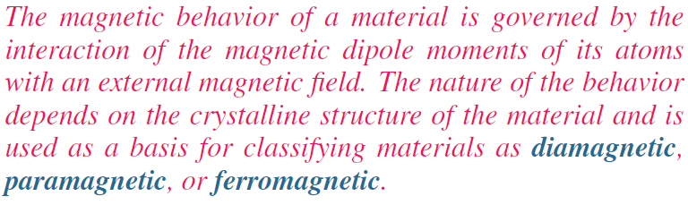

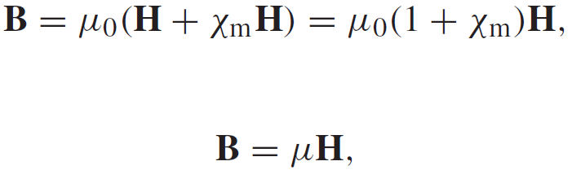
Magnetic Properties of Materials

Slide 28



Slide 29


Magnetic Hysteresis

Slide 30




Boundary Conditions

Slide 31





Inductance
Magnetic Flux
Flux Linkage
Inductance
Solenoid

Slide 32




Example 5-7: Inductance of Coaxial Cable
The magnetic field in the region S between the two conductors is approximately
Total magnetic flux through S:
Inductance per unit length:

Slide 33





Magnetic Energy Density
Magnetic field in the insulating material is
The magnetic energy stored in the
coaxial cable is

Slide 34
Formulas in Magnetostatics
Magnetic Force
Boundary Conditions
Biot-Savart Law
Ampere’s Law
Inductance
Constitutive Relation
Magnetic Energy Density

